Slide 1


R. N. G. Patel Institute of Technology (RNGPIT)
Computer Science and Engineering Dept.
Semester : 8th
Subject : Internship/Project (3183101)
Presentation - 2
Backend developer intern
Prepared By:: | Faculty Mentor:: | Industry Mentor::
Pansuriya Darshil J. 180840131033 | Mr. Nikunj Y. Kansara Assistant Professor CSE, RNGPIT | Ms. Priyanka Rajani Team Leader Infozium Solution PVT LTD

Slide 2
Outline
Overview of Company
Introduction of the Internship Work (Purpose, Objective, Scope, Technologies, Literature review)
Timeline Chart for 12 weeks Internship
Abstract of Project
Description of modules on which you have worked
Implementation Work
Test Cases
Problem Encountered by you and Possible Solutions
Summary of Internship
Conclusion
Limitation and Future Enhancement
References

Slide 3
Overview of Company
Infozium Solution PVT LTD which is Software Solution Base Company which is Located In Surat.
Goal of the Company is that to provide the good and reliable solution to Client. Working on Many Trending Technologies Like React Native ,Flutter, ReactJS, Node JS, PHP etc…
Company have many teams which have experts in that fields of technology and create a multiple solution with their expertise and provide it to client.
Infozium Group has become one of the most dependable technology partners for a variety of industries, particularly in their digitization efforts.

Slide 4
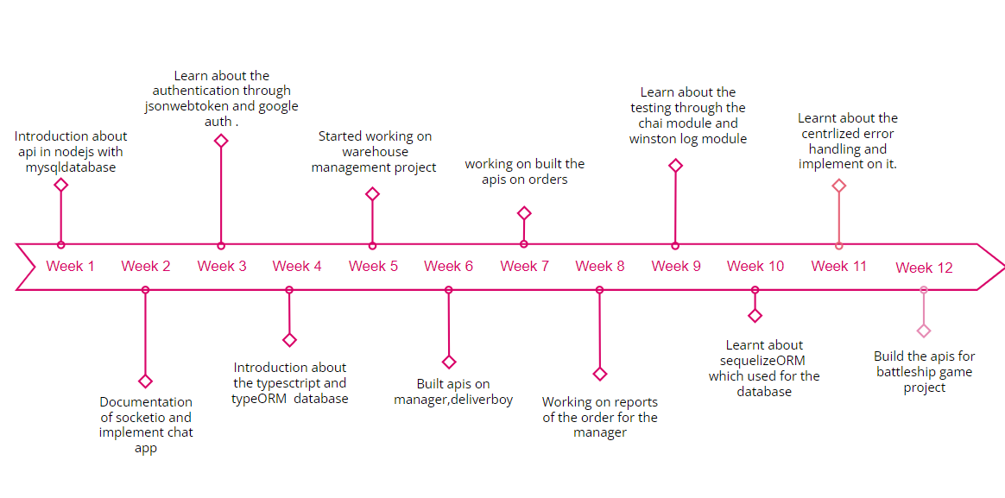
Timeline Chart for 12 weeks Internship

Slide 5
Introduction of the Internship Work
Main Purpose of an Internship that I want to learn new technologies which are use by the companies Nowadays.
To gain real work experience and provide meaningful assistance to the company.
To gain experience and skills in a particular field.
To develop professional contacts.

Slide 6
Abstract of Project
Warehouse management
Warehouse Management is based upon delivery services.It has mainly three Roles are Admin, Warehouse Manager and Delivery Boy In which admin and warehouse manager uses the web app and delivery boy uses the mobile app.
Admin can add/edit/delete Warehouse Manager and Delivery Boy as well apart from that admin can view/ edit delivery boy and Warehouse Manager. Admin can Manage, view, Assign Orders to Managers and Delivery Boys.
Warehouse Manager assign order to Delivery Boy and Download status of order and Payment Collection report.
Delivery Boy view all orders and Delivered the order and update the status of order and collect the payment.

Slide 7
Description of modules on which you have worked
Built the api for admin, manager, delivery boy.
Admin can create, block, edit manager and delivery boy and also create the warehouse and assign the warehouse manager to the warehouse.
Warehouse manager can upload the excel file which contains the unique number which gives by the admin, warehouse manager can view all orders and assign to the delivery boy.
Delivery boy can view all its order and deliver the order whether its for pickup or delivery. Collect the payment if the payment type is cash on delivery. Update the status of order either delivered or cancelled. He can view the history of orders and collected payment.
Manager can view the payment collection report of particular delivery boy.

Slide 8
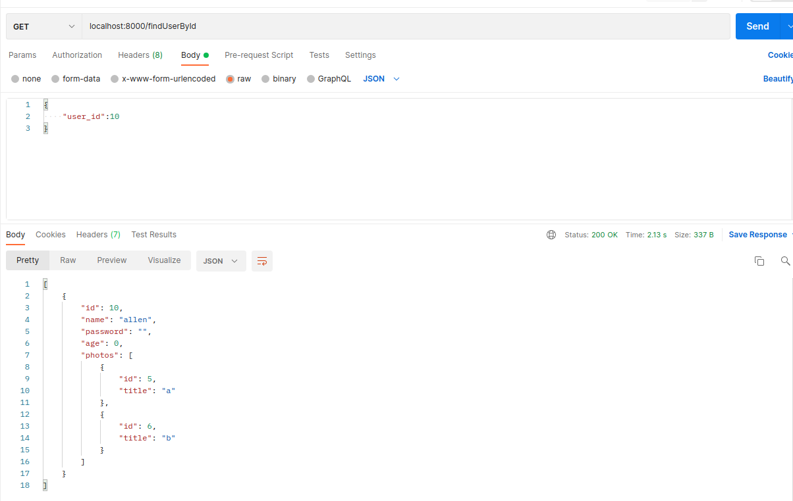
Training Work
Week 4

